Slide 1
Cross Band Transponder (XBT)
Andrew Robinson
Date of Last Edit: 12 March 2024
Special Acknowledgement: Dr. Joseph DiVerdi

Slide 2
High Level Needs (from Jonathan’s email)
Start with:
Single signal path
VHF voice signal transponded as a UHF voice signal
Could be a SDR w/digital radio chip
Could be analog
Fit onto a CubeSat board
Ideally 2” x 2” area
Radiation tolerant
Avoid CMOS

Slide 3
Goals
Multiple transponders on a single satellite
I.e., multiple up frequencies with multiple down frequencies
Low SWaP-C
Other desired capabilities?
Brainstorm session to build a “wish list”

Slide 4
Concept of Operations (CONOPS)

Slide 5
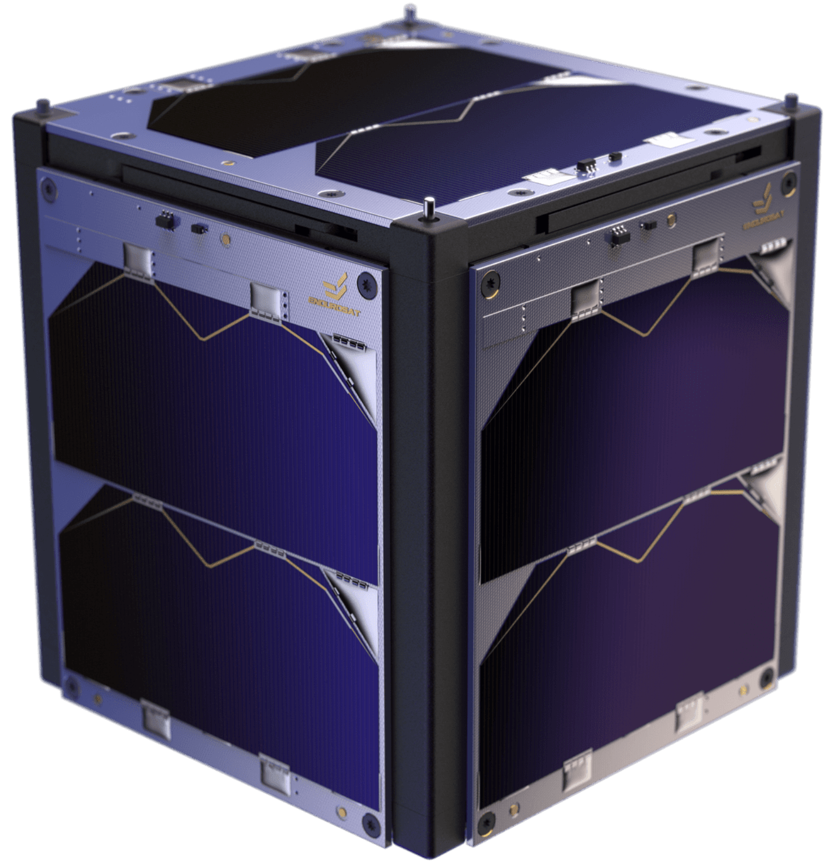




OV-1
Multiple (how many?) transponders on a single satellite
Up in VHF
Down in UHF
f_{UHF,N}
f_{UHF,1}
f_{UHF,2}
f_{VHF,N}
f_{VHF,1}
f_{VHF,2}

Slide 6
CONOPS
Main mission:
Receive TBD number of VHF signals from aperture
Amplify/filter/condition incoming signals for processing
Process signals
Filter/condition/amplify outgoing signal
Transmit UHF signals to aperture
Other Use Cases:
SOH, failure recovery
Store and forward?
Software updates
Different/new/etc. modes

Slide 7
Architecture

Slide 8
High-Level Block Diagram
144-146 MHz
420-450 MHz
LNA
PA
Down
Converter
Up
Converter
Signal
Processor
ADC
DAC
System of Interest

Slide 9
Context Diagram
Cross Band Transponder
Power
Commands
Host Bus
Tx Signals
Apertures
TLM
Rx Signals
Will the Bus have a comm system for TLM D/L or will the XBT be used?

Slide 10
Cross Band Transponder
To Components
Processor
DC/DC
Digital Up-converter
DAC
Tx Front End
PA
Power
Tx
Signals
Commands
Digital Down-converter
ADC
Rx Front End
TLM
Rx
Signals
RFIC
Reference signal: needed? (probably) → internal or external?

Slide 11
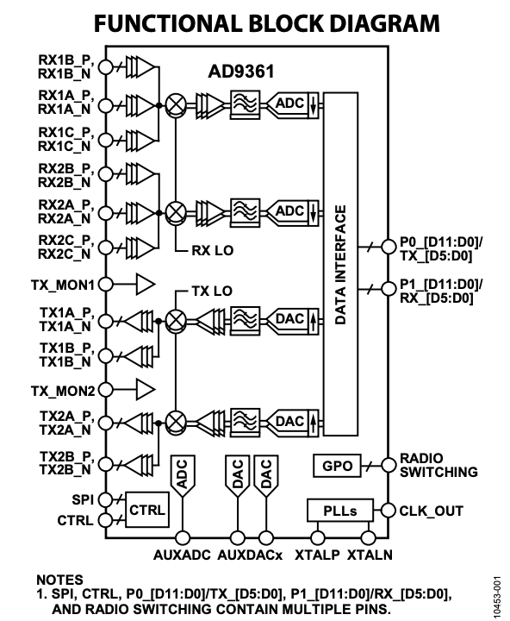
RFIC
Functionality needed:
Analog receive
Amplify
Mix with LO to IF
ADC
DAC
Mix with LO to RF
Analog transmit
Baseline: Analog Devices AD9361
12-bit DAC and ADC’s
TX: 47 MHz to 6.0 GHz, RX: 70 MHz to 6.0 GHz
Other options?
From AD9361 Data Sheet

Slide 12
Processor
Functionality needed:
Demodulate signal
Shift signal
What else..??
Notes/Questions/Observations:

Slide 13
Processor Exploration – scratch the ASCENT itch
Prompted a variety of LLM’s to brainstorm low power processor options:
TI Tiva C Series
STMicroelectronics STM32F7 Series
Microchip Technology PIC32MX Series
NXP Semiconductors i.MX6 Series
Espressif Systems ESP32/ESP8266
TI TMS320C6000 Series → see follow-on slide
Xilinx Zynq UltraScale+ MPSoC
Analog Devices ADSP-SC58x/ADSP-2158x
Microchip dsPIC33CH
Renesas R-Car V3H

Slide 14
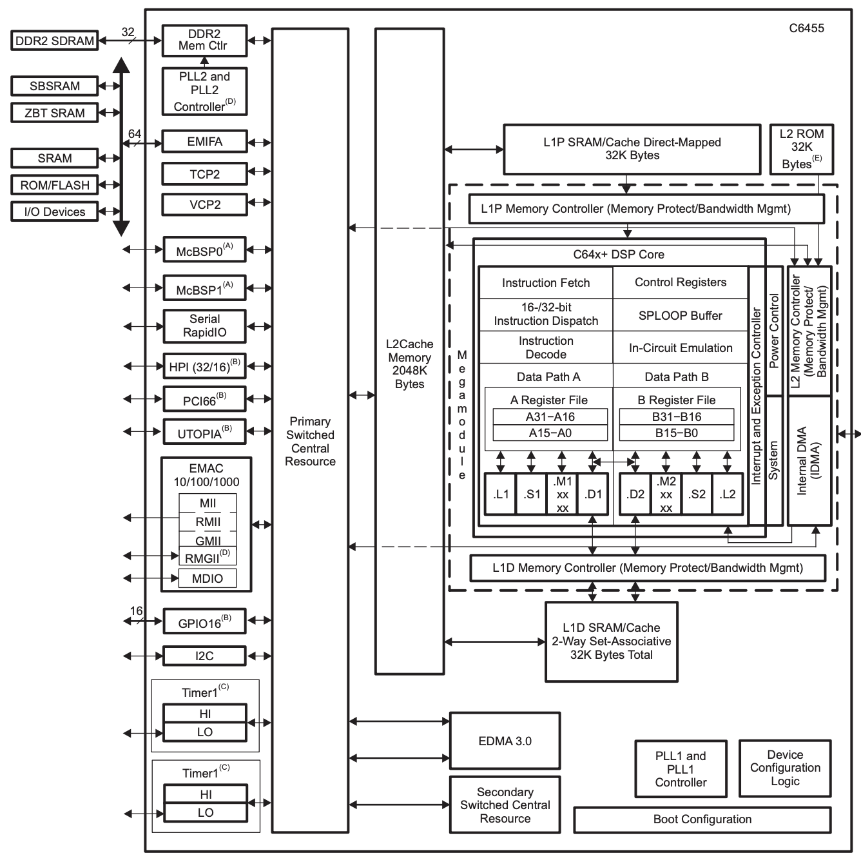
Processor Option (1 of n)
TI TMS320C6000 Series
High performance DSP w/low power
Very Long Instruction Word (VLIW) → efficient parallel processing
E.g., TMS320C6455BCTZA
-40C to 90C
1 GHz clock rate
$291.15 and 43 in stock (DigiKey)
Evaluation board: TMDXEV6455
$1,895.52 and 1 in stock (DigiKey)
Radiation-hardened version available → SMJ320C6701-SP

Slide 15
Processor Option (2 of n)
WIP

Slide 16
Power Amplifier (PA)
Functions → Form:
Amplify the RF signal
Notes/Questions/Observations:
What power is required to close the link?
Frequency, aperture, altitude dependent?

Slide 17
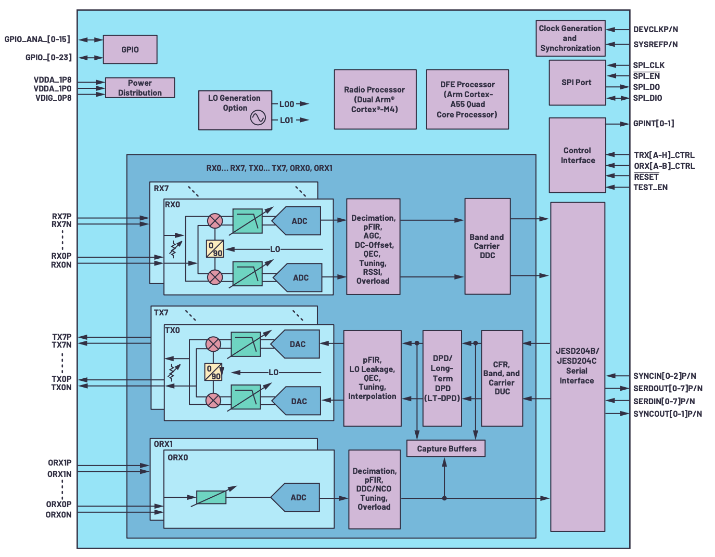
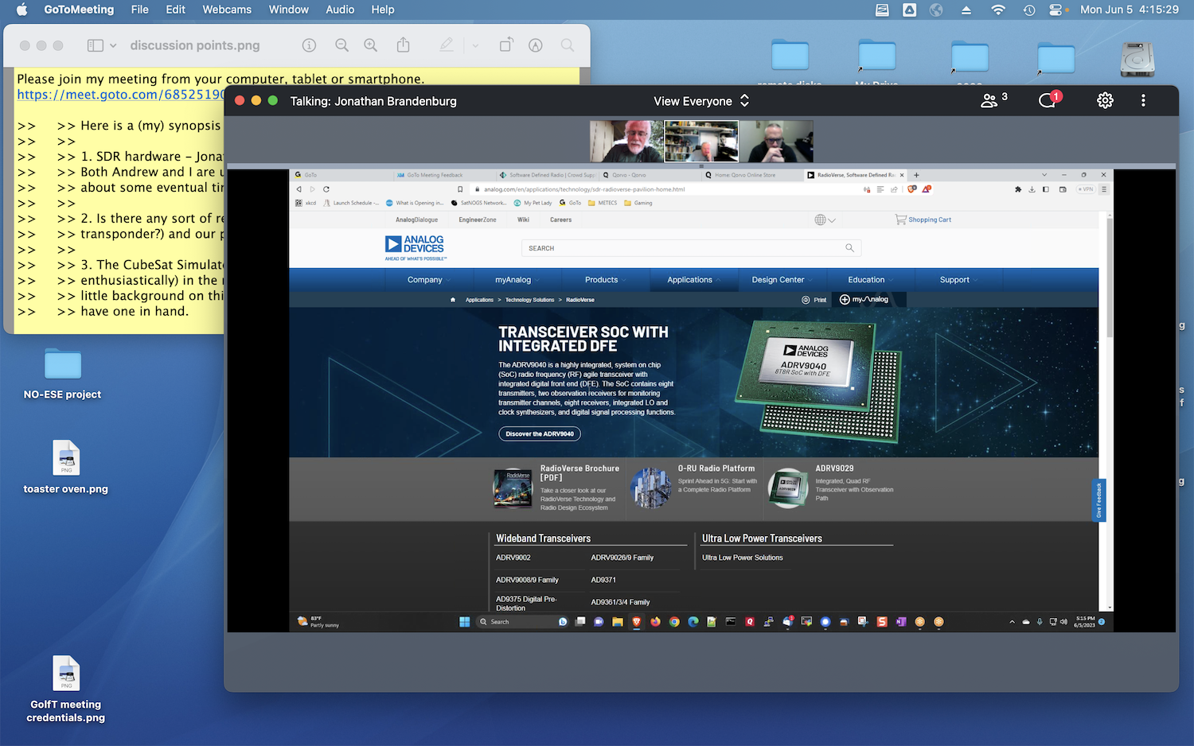
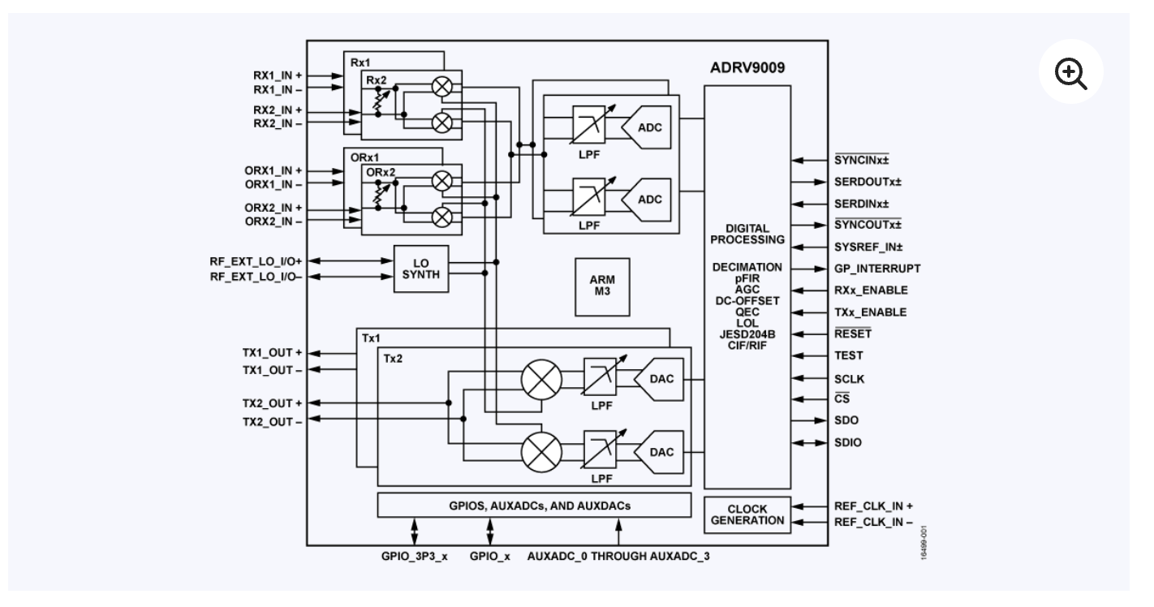
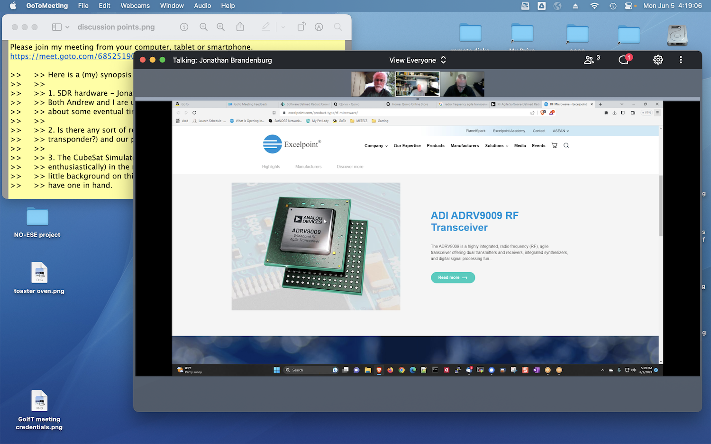
Other Potential Components to Explore
ADRV904x Block Diagram

Slide 18
Acronyms
Acronym | Definition
ADC | Analog to Digital Conversion
COTS | Commercial Off The Shelf
D/L | Downlink
DAC | Digital to Analog Conversion
DC | Direct Current
FM | Frequency Modulation
IF | Intermediate Frequency
LNA | Low Noise Amplifier
LO | Local Oscillator
PA | Power Amplifier
RF | Radio Frequency
RFIC | Radio Frequency Integrated Circuit
Rx | Receive
SDR | Software Defined Radio
TLM | Telemetry
Tx | Transmit
U/L | Uplink
XBT | Cross Band Transponder

Slide 19
Prototyping

Slide 20
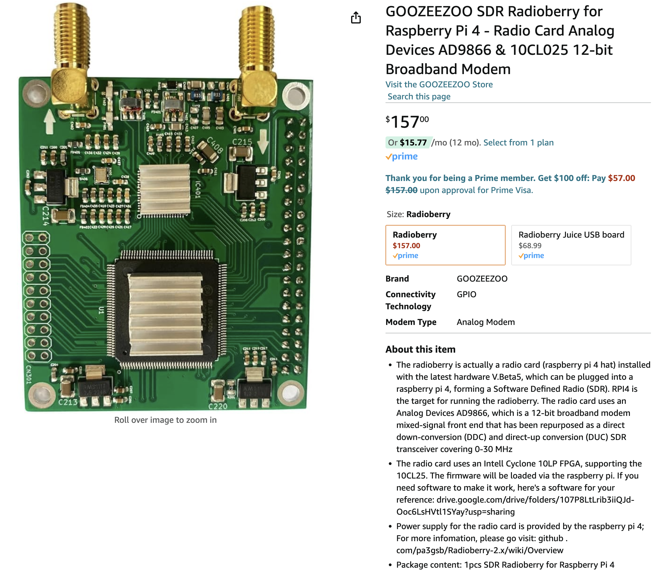
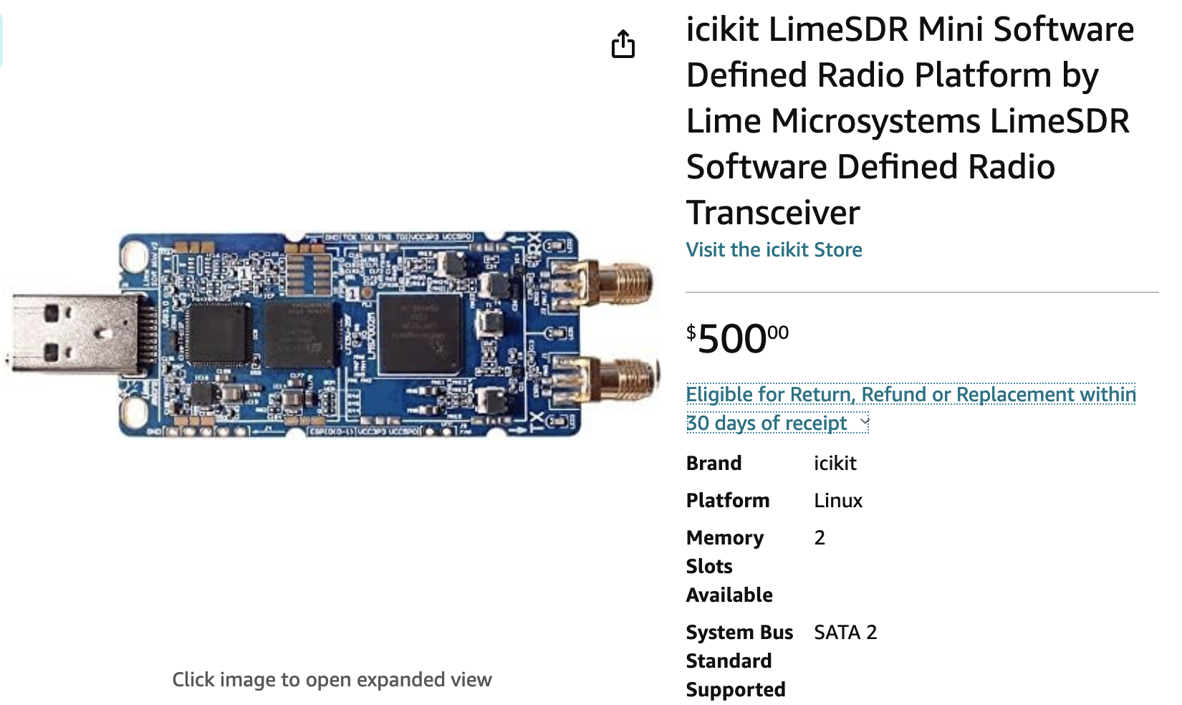
Early Prototyping Ideas
Potential Options:
Radioberry w/Raspbery Pi (and required converters)
LimeSDR
Others?
Purpose: Exploration on non-flight COTS parts to gain confidence/experience while going through conceptual design

Slide 21
Backup

Slide 22
Assumptions
# | Title | Assumption
1 | Input Power | A single source of power will be received from the bus Conversion and distribution of power is a function of the XBT
2
3
4
5
6
7
8

Slide 23
High-Level Questions
# | Question | Response
1 | Are there any desired additional capabilities that we can enhance with a digital design or a SDR design?
2
3
4
5
6
7
8

Slide 24
Requirements(-ish)

Slide 25
Design-y Questions
# | Question | Response
1 | What TLM is typically collected?
2 | How many signals?
3 | What is a good power draw to shoot for?
4 | Are reference signals (e.g., PPS, 50 MHz) available from the bus or should they be accounted for on the XBT?
5
6
7
8

Slide 26
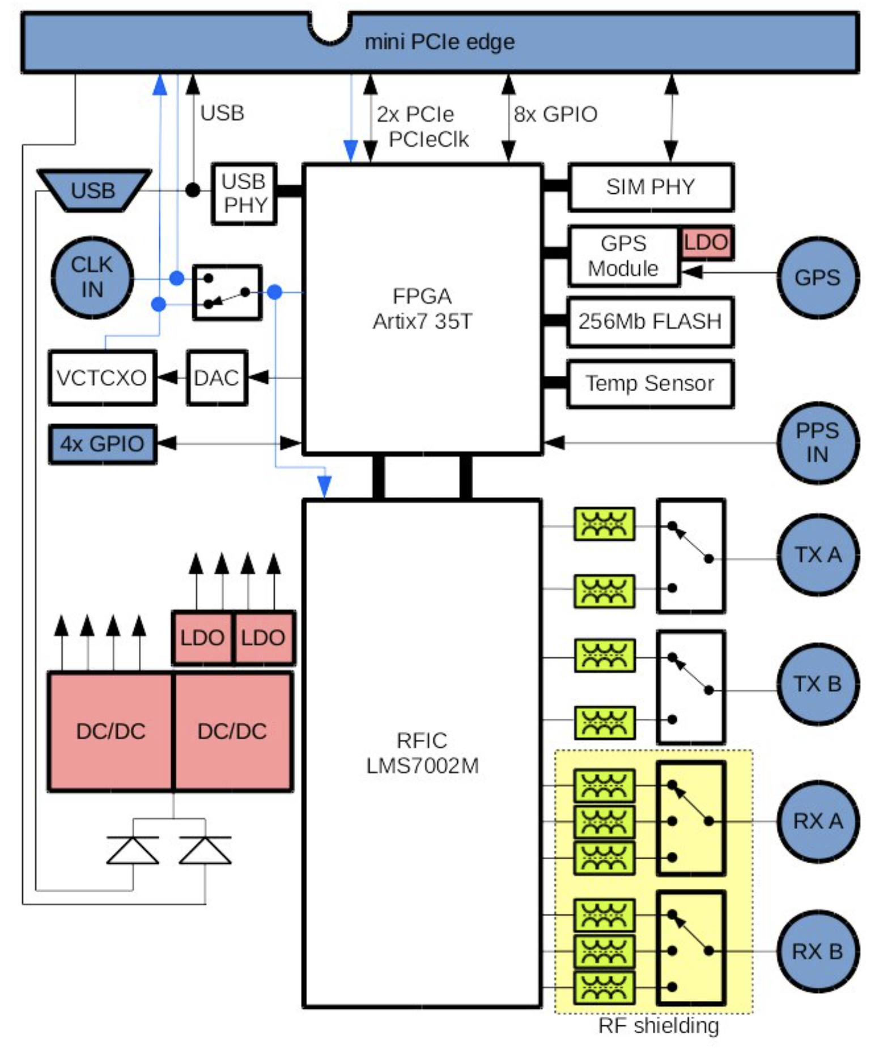
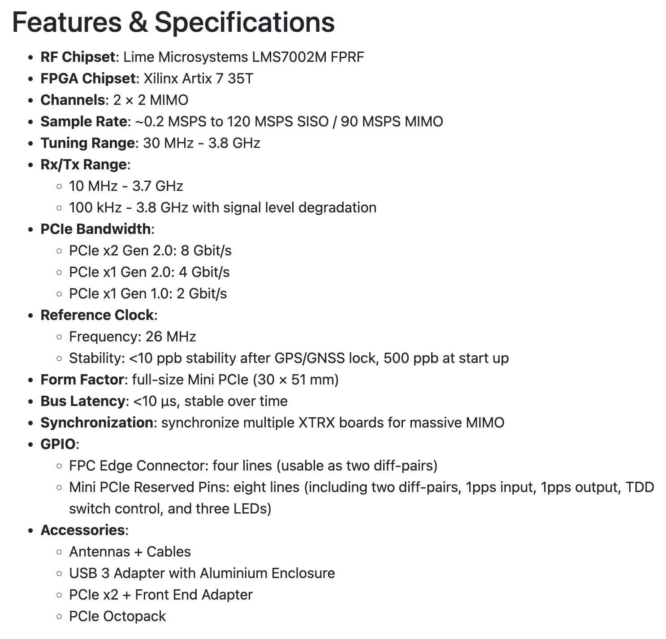
SDR
Fairwaves
XTRX
Source: https://www.crowdsupply.com/fairwaves/xtrx

Slide 27
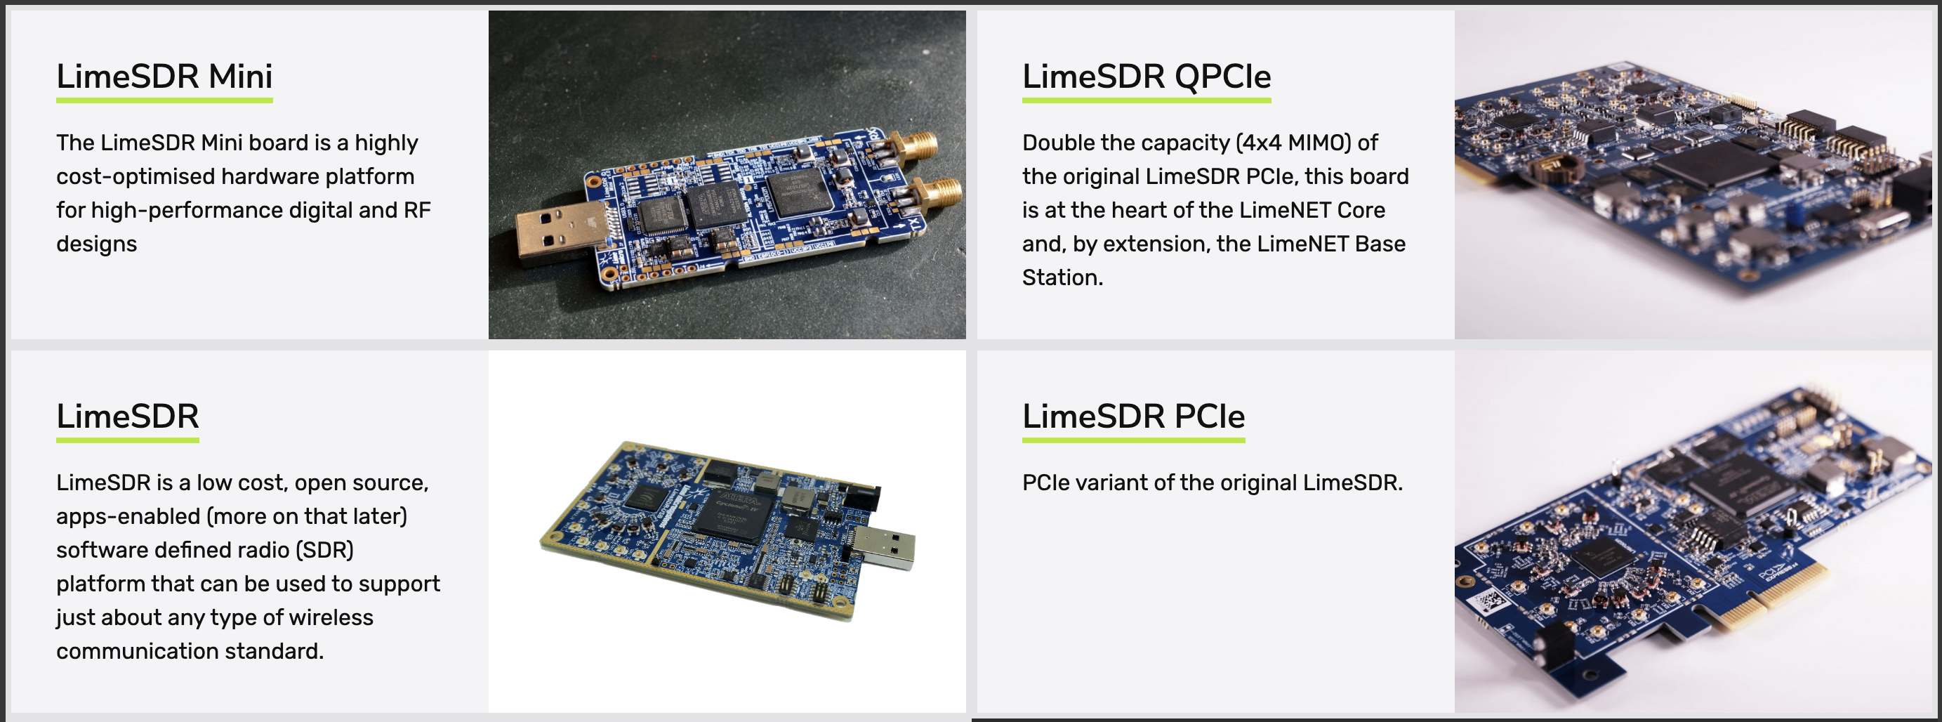
SDR
Lime Microsystems took over the XTRX (?)
Additional Options:
Source: https://limemicro.com/products/boards/

Slide 28
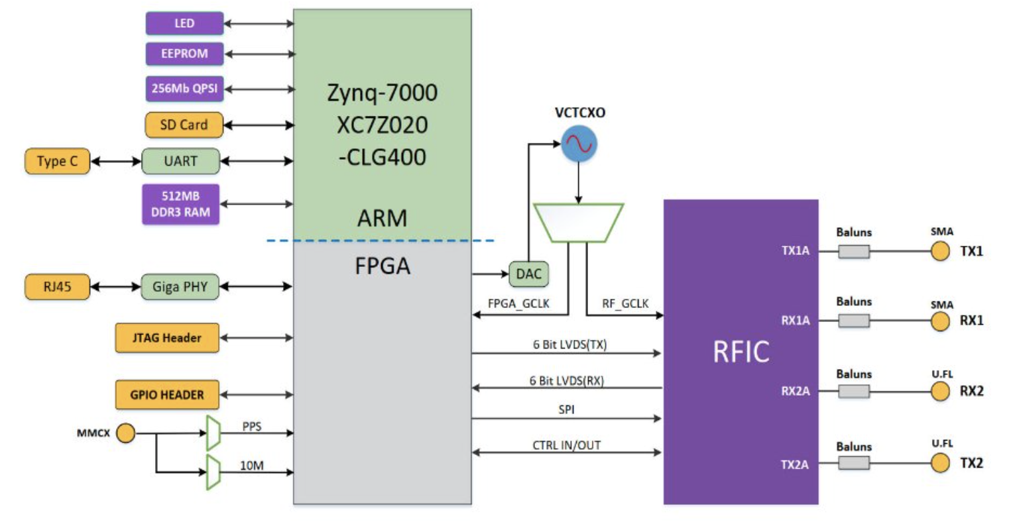
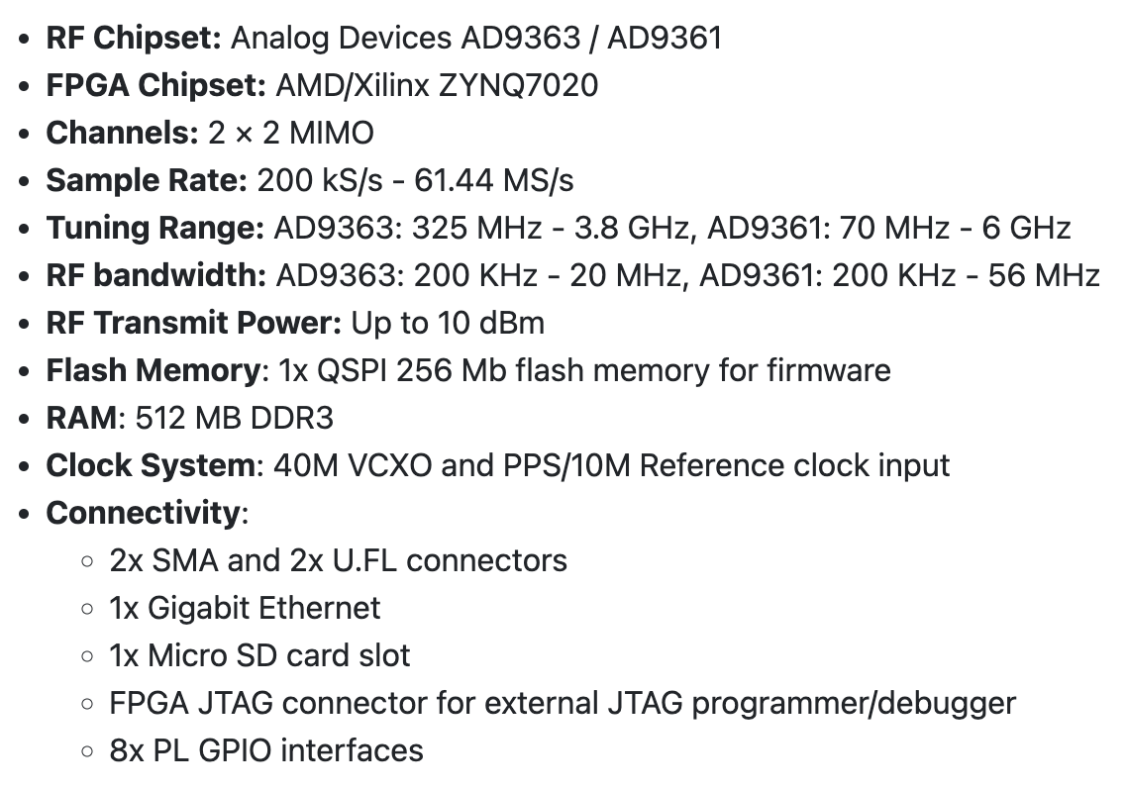
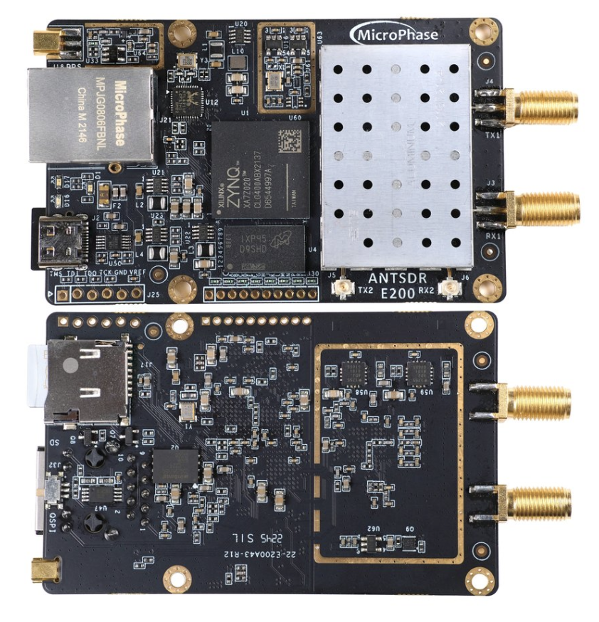
SDR
AntSDR E200

